Slide 1




General Software Development
Data Structures and Algorithms
SoftUni Team
Technical Trainers
Software University
http://softuni.bg

Slide 2

Table of Contents
What are Data Structures?
General knowledge about the most common types of Data Structures:
Usage
Performance
Operations
Basic Sorting Algorithms:
Bubble Sort
Quick Sort

Slide 3
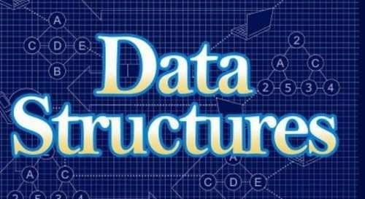
Data Structures

Slide 4
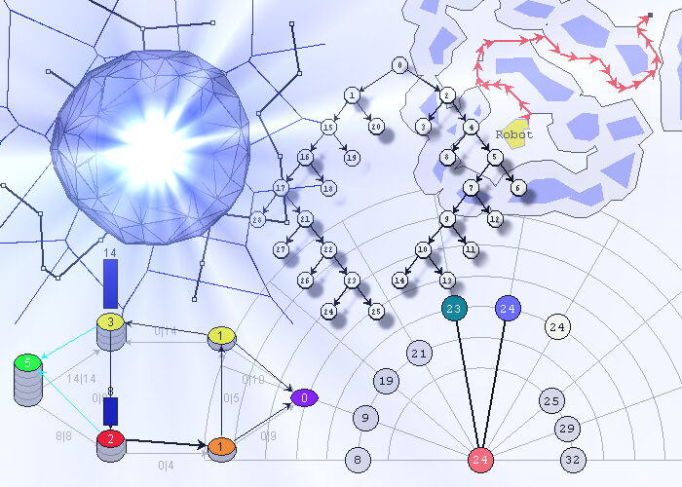
Data Structures
A Data Structure is a particular way of organizing data in a computer so that it can be used efficiently
Different kinds of data structures are suited for different kinds of applications
How the data is stored affects how the data is retrieved and manipulated

Slide 5
Data Structures
Some of the most used data structures are:
Arrays
A collection of elements of the same type with fixed size
Queues
A collection of elements of the same type, following the FIFO principle
Stacks
A collection of elements of the same type, following the LIFO principle
Linked Lists
A collection of linked elements of the same type, each pointing to the next

Slide 6
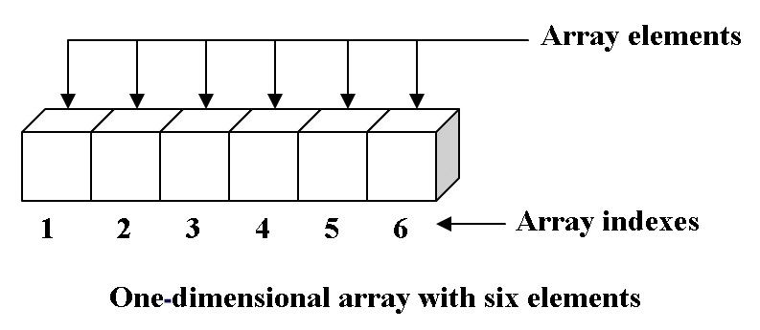
Arrays
A collection of items stored in a contiguous memory location and addressed using one or more indices
Size is determined is determined at the moment of its initialization

Slide 7
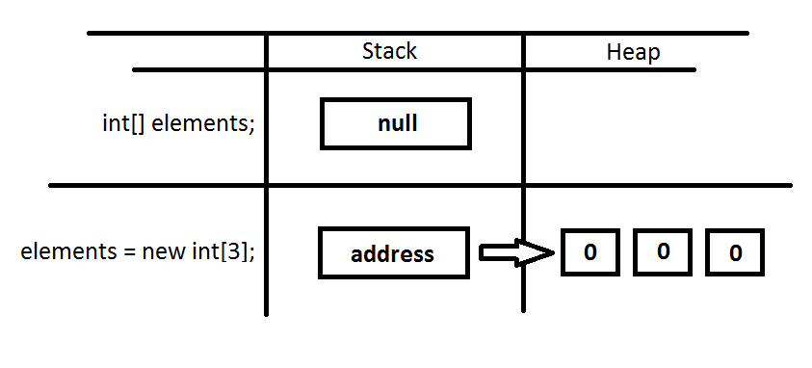
Arrays
Internal Representation
When not initialized the array is set to null
At the moment of initialization, memory is allocated in the heap for the array’s elements

Slide 8
Arrays
Common Operations
Allocation - working with an array requires you to allocate the memory by creating and initializing it
Access - you can access any array element by directly referring to its index
Performance and Usage
Work with a set of values of the same data type
Work best when the number of items in the collection is predetermined and fast, direct access to each item is required

Slide 9

Queues

Slide 10
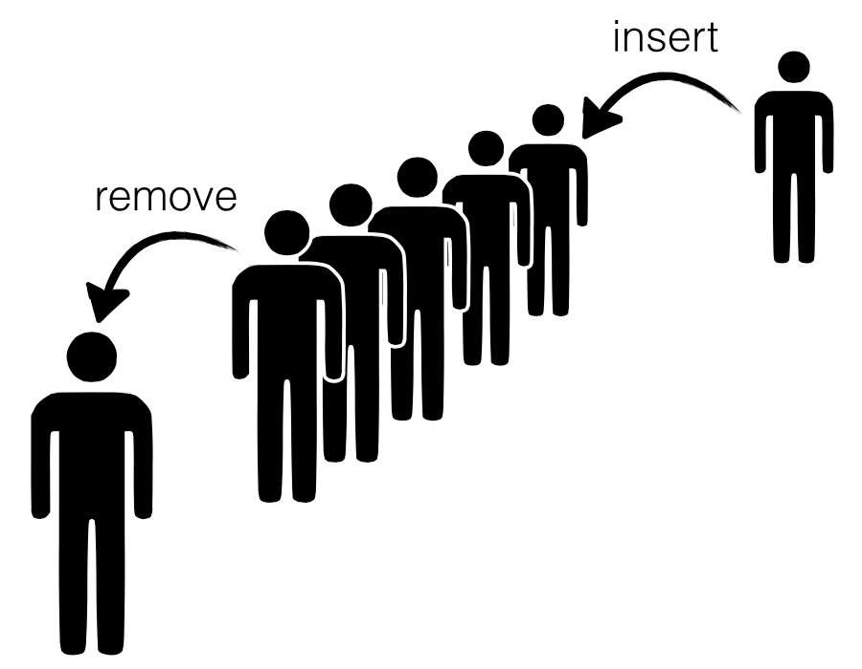
Queues
A linear collection that are inserted and removed according to the first-in first-out (FIFO) principle
The first added element is the first removed, resembling a real-life queue
The capacity of a queue is automatically increased, as new elements are added

Slide 11
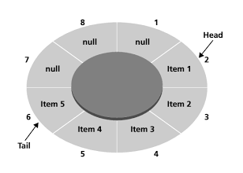
Queues
Internal Representation
Within a queue, the head index points to the first item, and the tail index points to the last item
If an item is removed the head moves to the next item
If an item is added the tail moves to the new item

Slide 12
Queues
Common Operations
Enqueue – adds a new item to the tail of the queue
If there is no space available, reallocates the memory for the collection with a pre-specified growth factor, extending its capacity
Dequeue – removes the item at the head of the queue and sets the head to point at the next element
The operation itself returns the removed item as a pure value
Peek – allows you to look at the head item without removing it from the queue
Contains – checks whether a specific item exists in the queue

Slide 13
Queues
Performance and Usage
Best suited for applications in which you need to process items in the order they were received
Handling many requests from a particular application
Printing or uploading many images
Anywhere, where you will have a large input of items which must be scheduled and processed, according to some predefined policy
Unlike an array, a queue cannot be used to randomly access elements
Operations such as enqueue and dequeue actually add and remove the items from the queue

Slide 14

Stacks

Slide 15
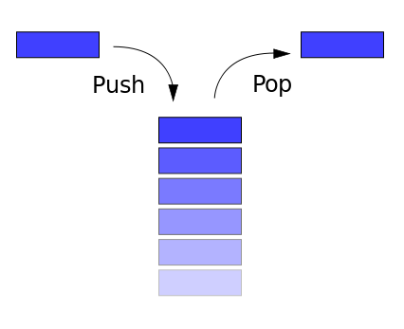
Stacks
A linear collection that are inserted and removed according to the last-in first-out (LIFO) principle
As opposed to queues, in a stack, the last added element is the first removed (LIFO)
It is named stack as it behaves like a real-world stack, for example − deck of cards, pile of plates etc.

Slide 16
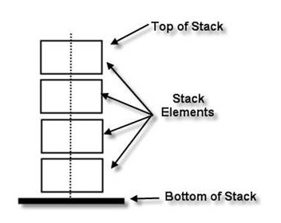
Stacks
Internal Representation
Similar to the queue, a stack has two edge elements
The top and the bottom of the stack
You can only remove the element at the top of the stack
If you want to access an element at the middle you might have to first take out all the elements before it

Slide 17
Stacks
Common Operations
Push – adds a new element at the top of the stack
Similar to the queue, reallocates memory to create additional space if there is none
Pop – removes the top element of the stack
The operation itself returns the removed element as a pure value
Peek – allows you to look at the top element without removing it from the stack
Contains – checks whether a specific element exists in the stack

Slide 18
Stacks
Performance and Usage
Best suited for applications in which you have operations over the last processed item
Backtracking, Undo/Redo operations in text editors
Expression evaluations / Syntax parsing
Memory management, run-time environment for nested language features
Same as the queue
the stack cannot be used to randomly access elements
The operations push and pop actually remove items from the stack

Slide 19
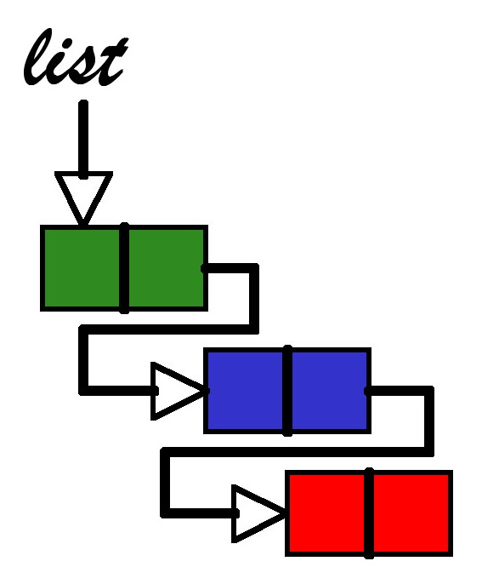
Linked Lists

Slide 20
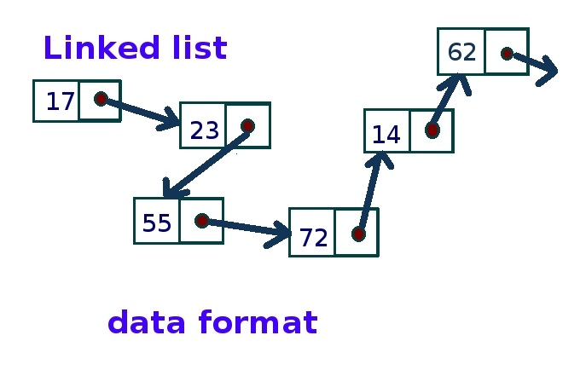
Linked Lists
A linear collection of nodes, in which each node contains a pointer to the next one
Each node contains two pieces of information
The data corresponding to the node
The pointer to the next node
The first node is called the head
The last one is the tail

Slide 21
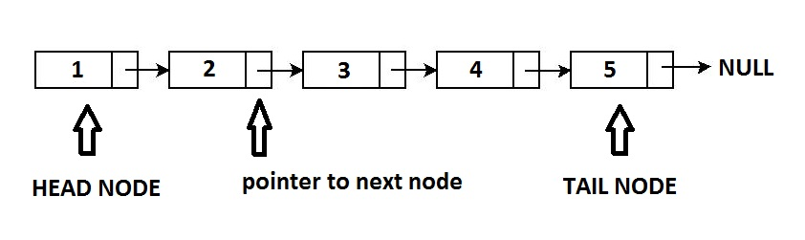
Linked Lists
Internal Representation
In Singly Linked List access is given only in one direction, thus accessing singly listed elements is Unidirectional
Last node’s pointer to its successor is NULL

Slide 22
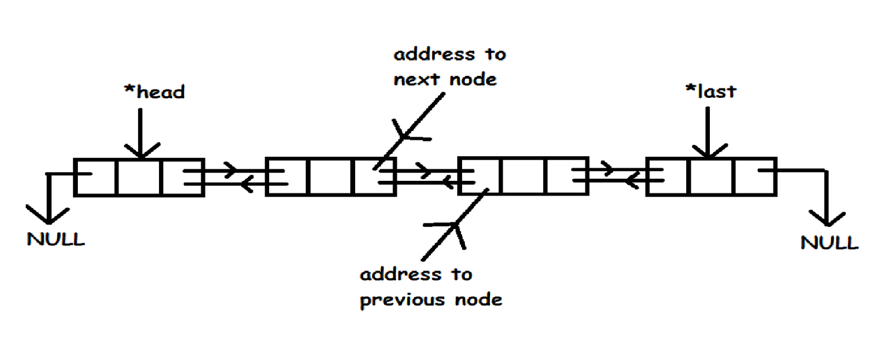
Linked Lists
Internal Representation
In Double Linked List every node holds a link not only to the next but also to the previous node
The first and the last node’s pointer, to their predecessor / successor is NULL

Slide 23
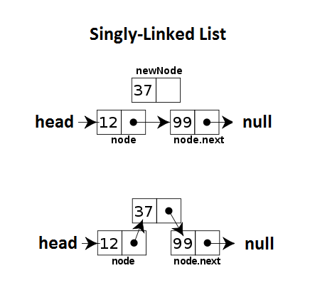
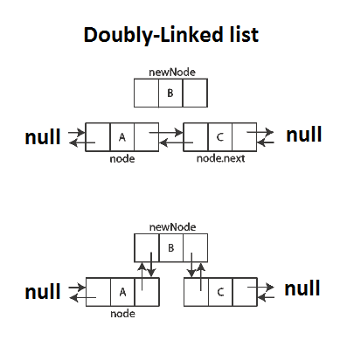
Linked Lists
Common Operations
Add – Adding or inserting an item in a linked list is a matter of changing links

Slide 24
Linked Lists
Common Operations
Remove – similar to the Add operation the remove operation also changes links
In a singly-linked list, when a node is removed, the link to the next node is given to the one before the removed node
In a doubly-linked list, the principle is the same with the addition that the link to the previous node is also allocated
Find – the find operation searches for a particular node, by given value, in the Linked list.
To find it, it always performs a linear search which makes it particularly slow

Slide 25
Linked Lists
Performance and Usage
Provides extremely fast insertion and deletion of elements, because it involves simply changing links
Does not allow random access to its elements
Linked lists are particularly slow at retrieving data, due to the fact that looking for a certain node in them requires a linear search
Linked lists do not have a maximum capacity, after which they need reallocation of memory, which is another thing that makes them fast
Finds use in applications where frequent insertion and deletion of elements is required

Slide 26

Live Demo

Slide 27
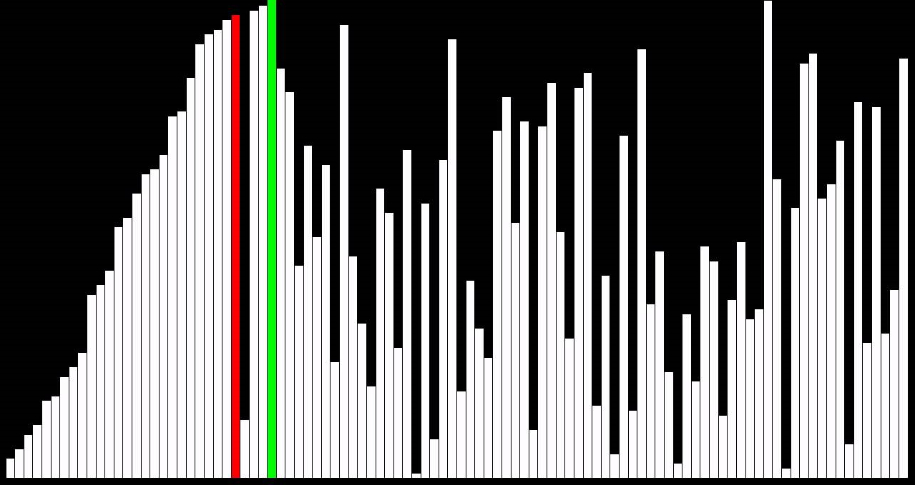
Simple Sorting Algorithms

Slide 28

Bubble Sort
The Bubble Sort algorithm compares each pair of adjacent items and swaps them if they are in the wrong order
The bubble sort algorithm gets its name from the fact that during its execution, the smaller items get “bubbled”
The algorithm traverses the whole list and only stops when it scans fully and finds no elements which need to be swapped

Slide 29
Bubble Sort
30
40
20
50
30
40
20
50
30
40
20
50
30
20
40
50
30
20
40
50
30
20
40
50
30
20
40
50
20
30
40
50

Slide 30
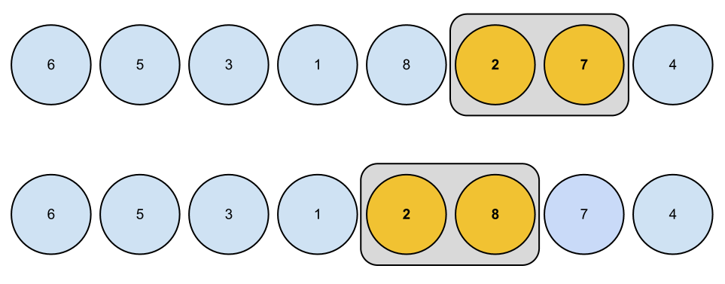
Live Demo

Slide 31

Quick Sort
Quicksort is a divide and conquer algorithm.
Quick sort first divides a large array into two smaller sub-arrays: the low elements and the high elements
Quick sort can then recursively sort the sub-arrays
Quick sort continues to divide the sub-arrays until the size of the problem is small enough, to require no sorting

Slide 32
Quick Sort
STEP | DATA |  |  |  |  |  |  | COMMENTS
1 | 360, 45, 180, 90, 270 |  |  |  |  |  |  | Pick any element as the pivot element (the one that will divide the list. In this case 180.
2 | 90, 45 |  | 180 |  |  | 360, 270 |  | Split the list into two partitions, putting those elements smaller than the pivot in the left partition, and those greater than it, in the right. Then for each of those partitions do the same steps till now.
3 | 45 | 90 |  | 180 | 270 |  | 360 | 45 is less than the pivot (90) so it goes left, 360 is greater than the pivot (270) so it goes right. On the next step we get lists consisting of one element, which are, by definition, sorted.
4 | 45, 90, 180, 270, 360 |  |  |  |  |  |  | Finally, we merge the partitions into one complete, sorted list.

Slide 33
Live Demo

Slide 34

Summary
What are Data Structures and why are they useful to us?
What are the properties of some of the most used Data Structures?
What are the advantages and disadvantages of the different types of Data Structures?
What are Bubble Sort and Quick Sort?
How do they work, and how efficient are they?

